Slide 1



AWS IoT
Introduction
<number>
Version 1.0.0
Notes:
<number>

Slide 2
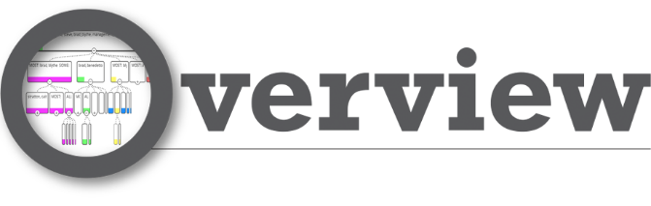
Device SDKs
Security
Device Shadow
Rules Engine
Device Gateway
Device Registry
<number>

Slide 3
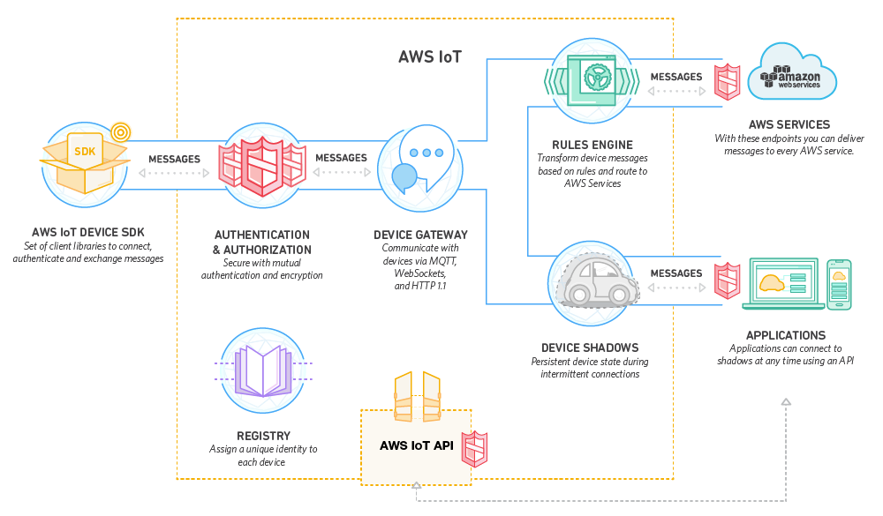
<number>

Slide 4
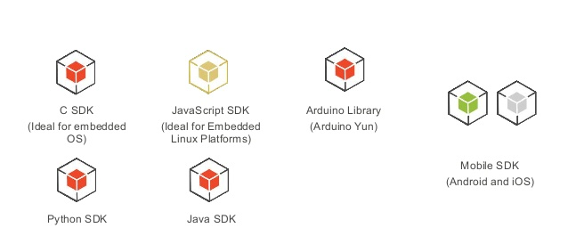
DEVICE SDKs
Helps you quickly and easily connect your hardware to AWS IoT
Source library, samples, porting guide, documents are provided
<number>

Slide 5
SECURITY
TLS authentication
Bring your own certificate
Create CSR
Create X.509 certificate from CSR
Activate the certificate
Create Policy
Attach policy to certificate
Note: Certificate must be issued by AWS IoT
Use certificates issued by your own CA
New API calls to support management of certificates
<number>

Slide 6
SECURITY
AWS IoT policies
Securing user access
Effect: allow or deny
Action: Publish, subscribe, update, retrieve and delete
Resource: client, Topic ARN or Topic filter ARN
WebSockets support Signature Version 4 authentication
IAM roles and policies
Amazon Cognito identity pools
<number>

Slide 7
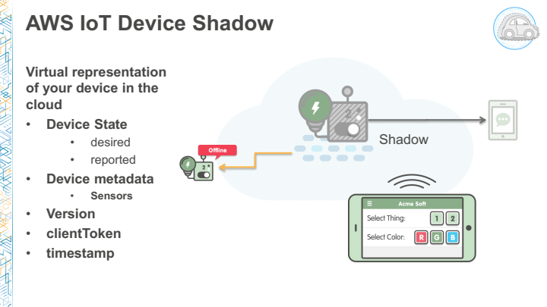
DEVICE SHADOW
<number>

Slide 8
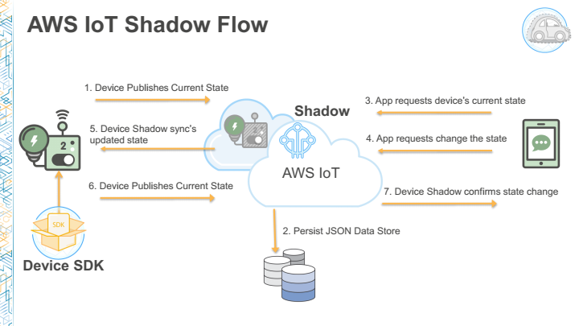
DEVICE SHADOW
<number>

Slide 9
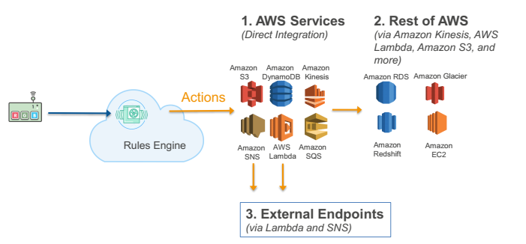
RULES ENGINE
Connects AWS IoT to External Endpoints and AWS Services
Evaluates inbound messages published into AWS IoT
Transforms and delivers messages to appropriate endpoints
<number>

Slide 10
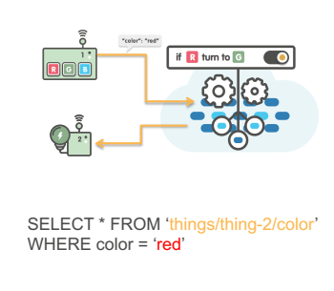
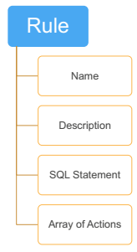
RULES ENGINE
Simple & Familiar SQL syntax
SQL Statement to define topic filter
Optional WHERE clause
Advanced JSON support
Functions
String manipulation
Mathematical operations
Context based helper functions
Crypto support
UUID, Timestamp, rand, etc.
Execute simultaneous actions
<number>

Slide 11
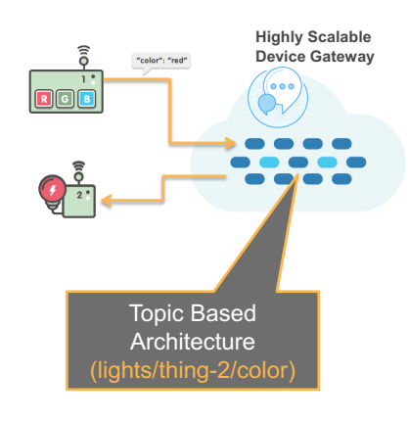
DEVICE GATEWAY
<number>

Slide 12
DEVICE GATEWAY
Publish/Subscribe
Sensor Messages
Standard Protocol Support
MQTT
HTTP
WebSockets
Long Lived Connection: Receive signals from the cloud
Secure By Default: Connect securely via X.509 Certs and TLS 1.2 Client Mutual Auth
Standard Protocol Support
MQTT
HTTP
WebSockets
Topic/Channel: Message routing hierarchy Control over full tree
Payload (JSON): Customer-defined JSON payload
<number>

Slide 13
DEVICE REGISTRY
Static attributes associated to Thing
Firmware version
Serial Numbers
Device Type
Device Group
Device Description
Sensor Description
Support and Maintenance
Reference Manual URL
Part # reference
Reference to external support system
<number>

Slide 14
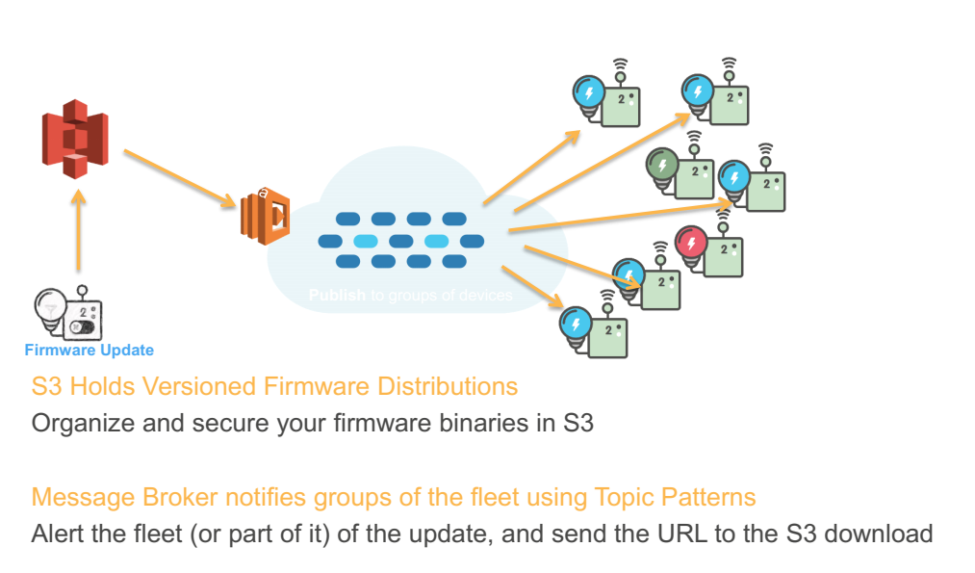
DEVICE REGISTRY
Ability to upgrade global or with a region
Rulses Engines helps keeping state of updates and tracks progress in a DynamoDB Table
Store Version in Registry Entry
<number>

Slide 15


Thank you!
Email
Website:
Vietnam:
North America:
+84-2839-951-059
+1 844 224 4188
Australia:
Japan:
+61 414 734 277
+81 364 324 994
Email
Website:
innovation@tma.com.vn
http://tma-innovation.center
Notes:
<number>

